Slide 1
MISP-Malware Information Sharing Project
Sarah Noles, Brian Mellon, Greg Hoff, and Carl Deicke

Slide 2
What is MISP
An open source threat intelligence platform, using open standards for threat sharing.
Mostly written in PHP

Slide 3
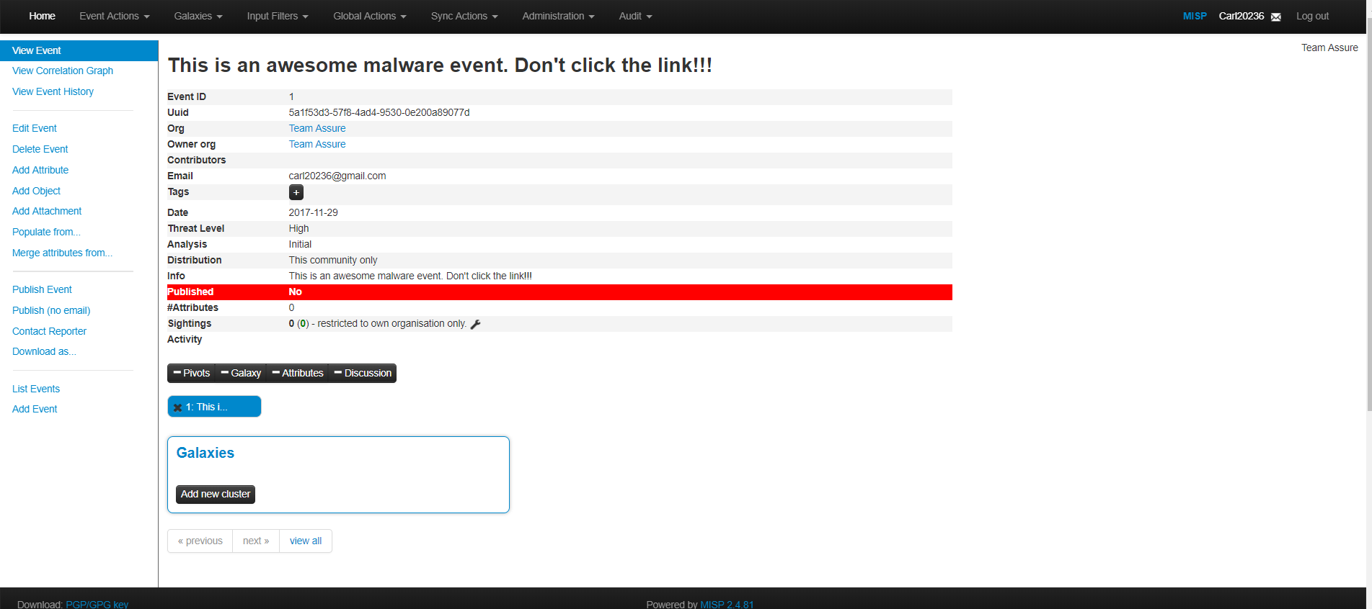
Event Information

Slide 4
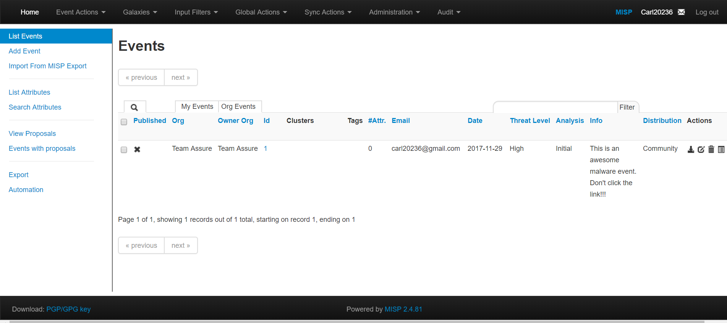
All Events

Slide 5
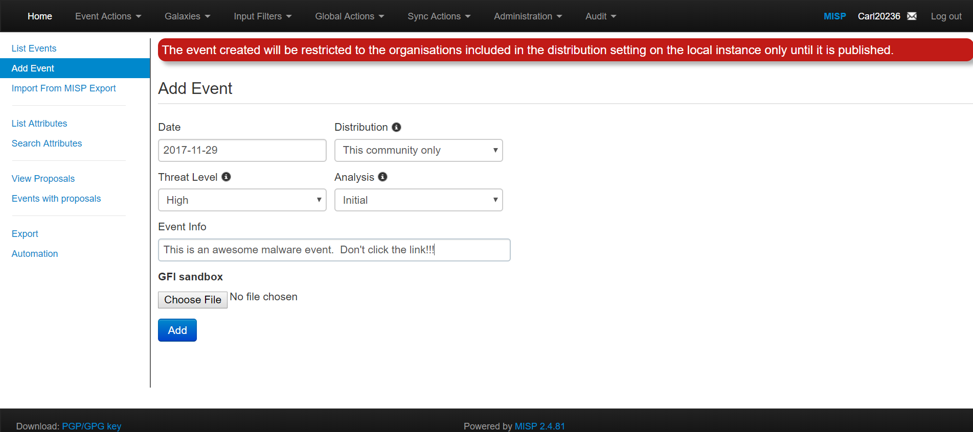
Add Event

Slide 6
Assurance Claims
The system's authentication mechanism is acceptably secure against common authentication attacks.
There are no exploitable Cross-Site Scripting weaknesses in the code.
Role based access is implemented in an acceptably secure manner

Slide 7
Assurance Claims Cont.
System prevents distribution of event information to those who are not permitted to view it.
The user management interface is acceptably secure.

Slide 8
Gaps in security requirements
Apache configuration
Firewall configuration
SMTP configuration

Slide 9
Code Review Findings

Slide 10
Automated Scan Findings
Used two tools
RIPS
Found 296 issues
File Disclosure (101)
File Manipulation (40)
Command Execution (34)
Code Execution (29)
Cross-Site Scripting (28)

Slide 11
Automated Scan Findings
SWAMP
Found 22,207 issues
Most issues found were where the actual code deviated from generally accepted coding conventions
Debate within the MISP GitHub forums about which coding convention to use
not strictly a weakness or vulnerability
Difficult for MISP to alleviate these coding issues as they rely on CakePHP, where the majority of these issues reside

Slide 12
Automated Scan Findings
SWAMP Report cont.
Number of issues by code source:
CakePHP | 17,568
PHP (MISP written) | 3,955
CSS | 560
Javascript | 124

